Slide 1
Covid-19 in India Tableau Dashboard Analysis
File created on: 1/10/2023 7:44:02 PM
By: Krrish Mahajan

Slide 2
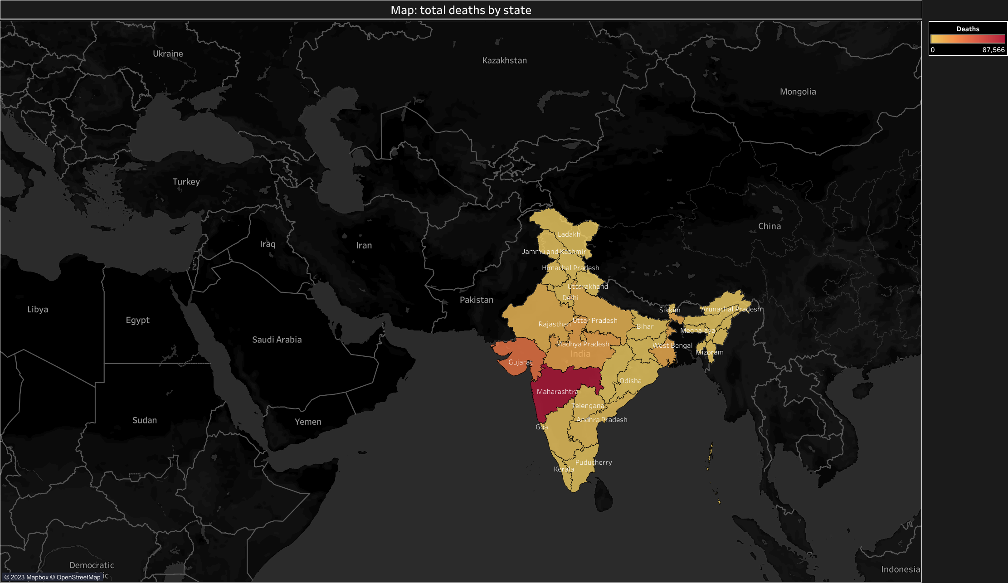

Slide 3
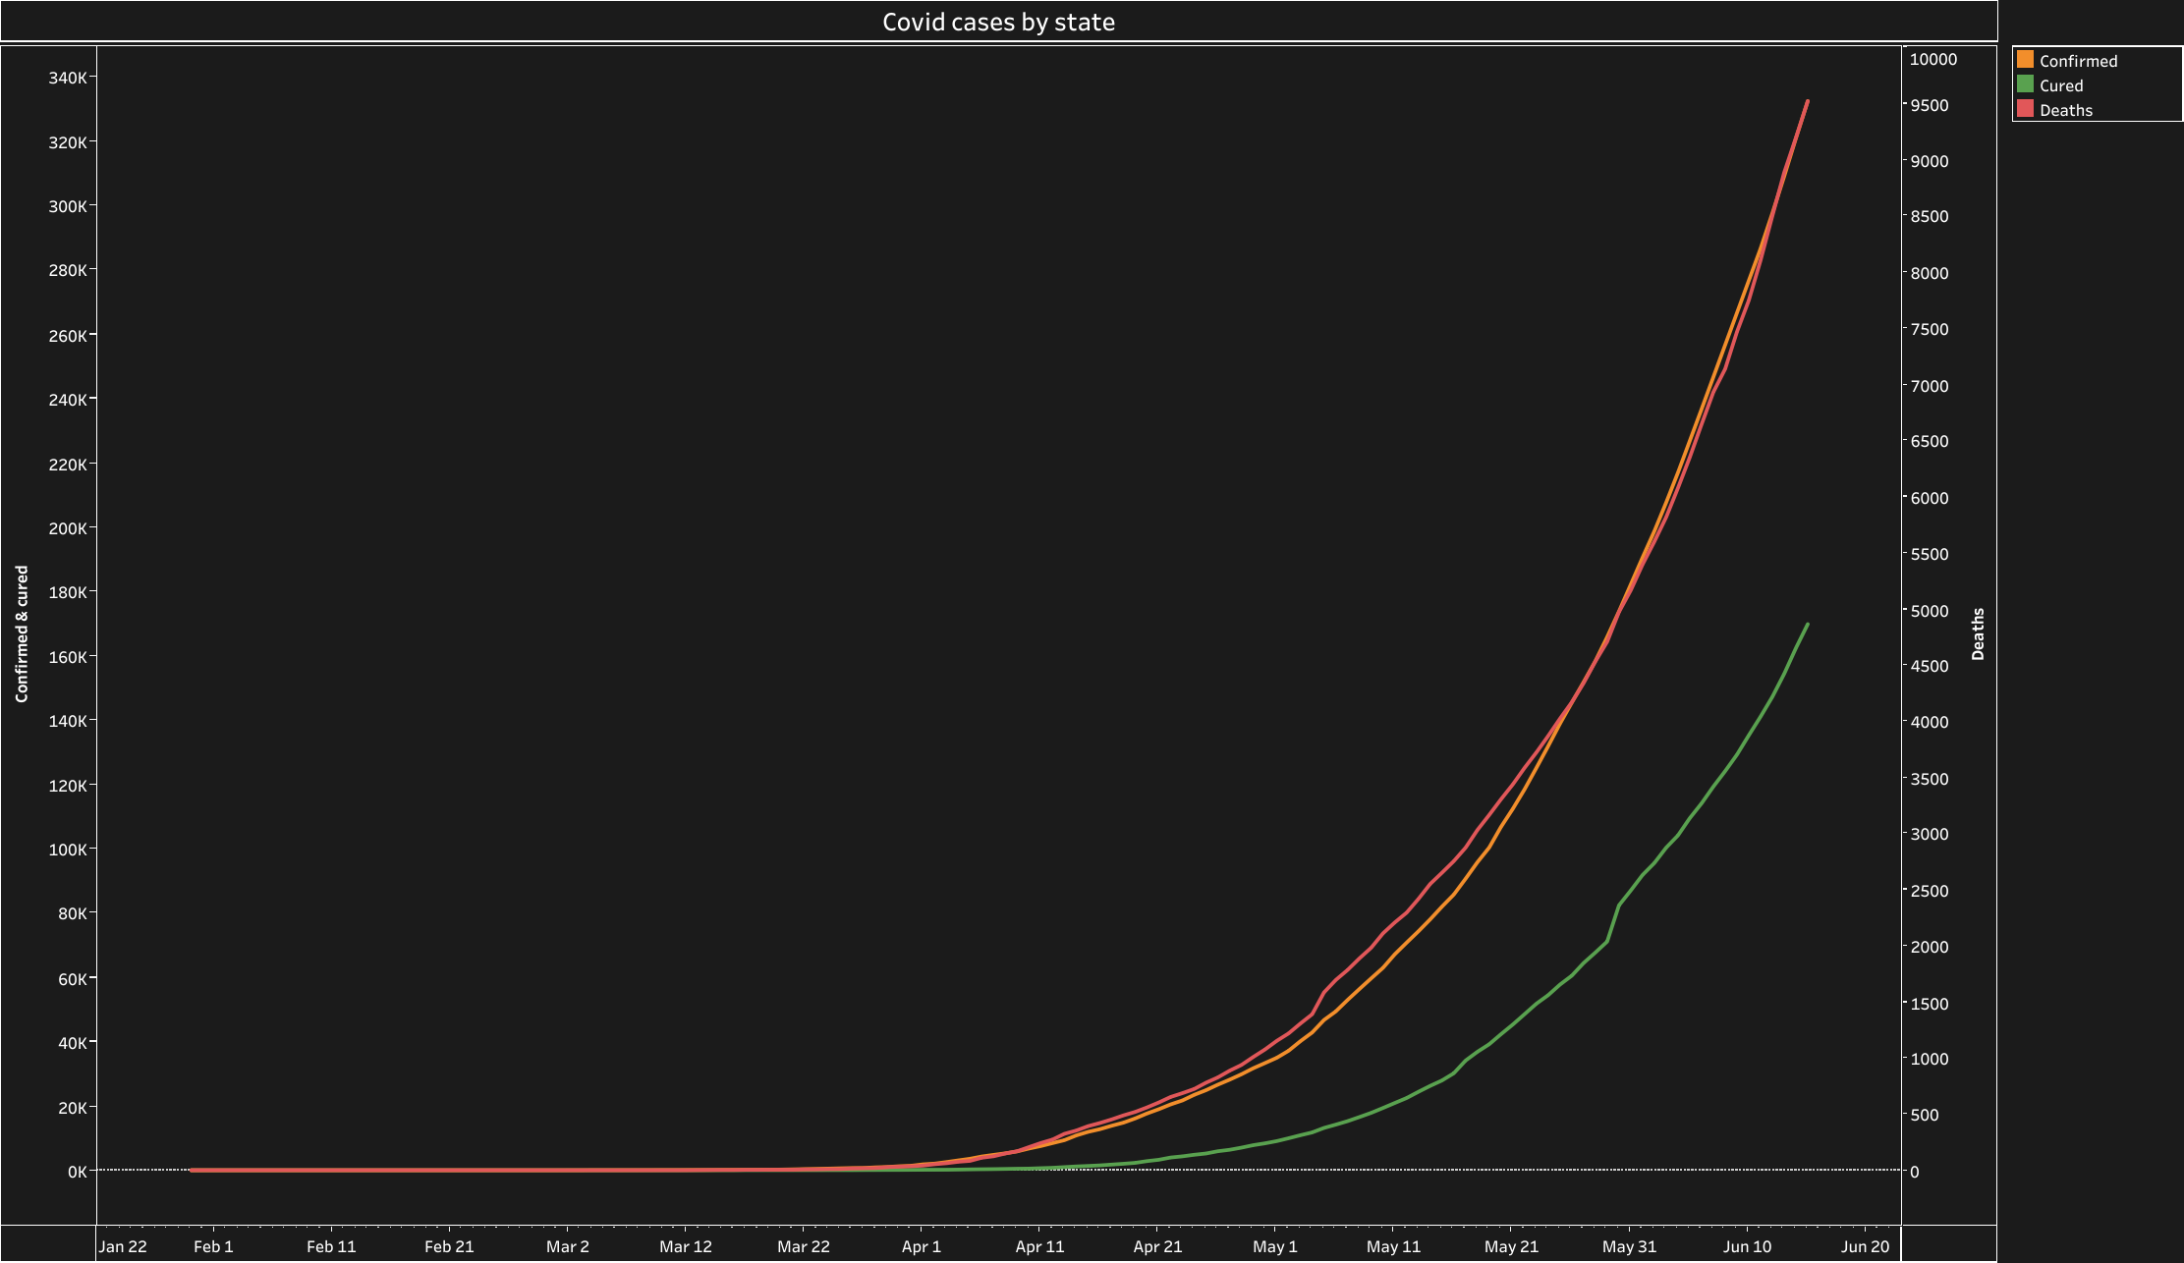

Slide 4
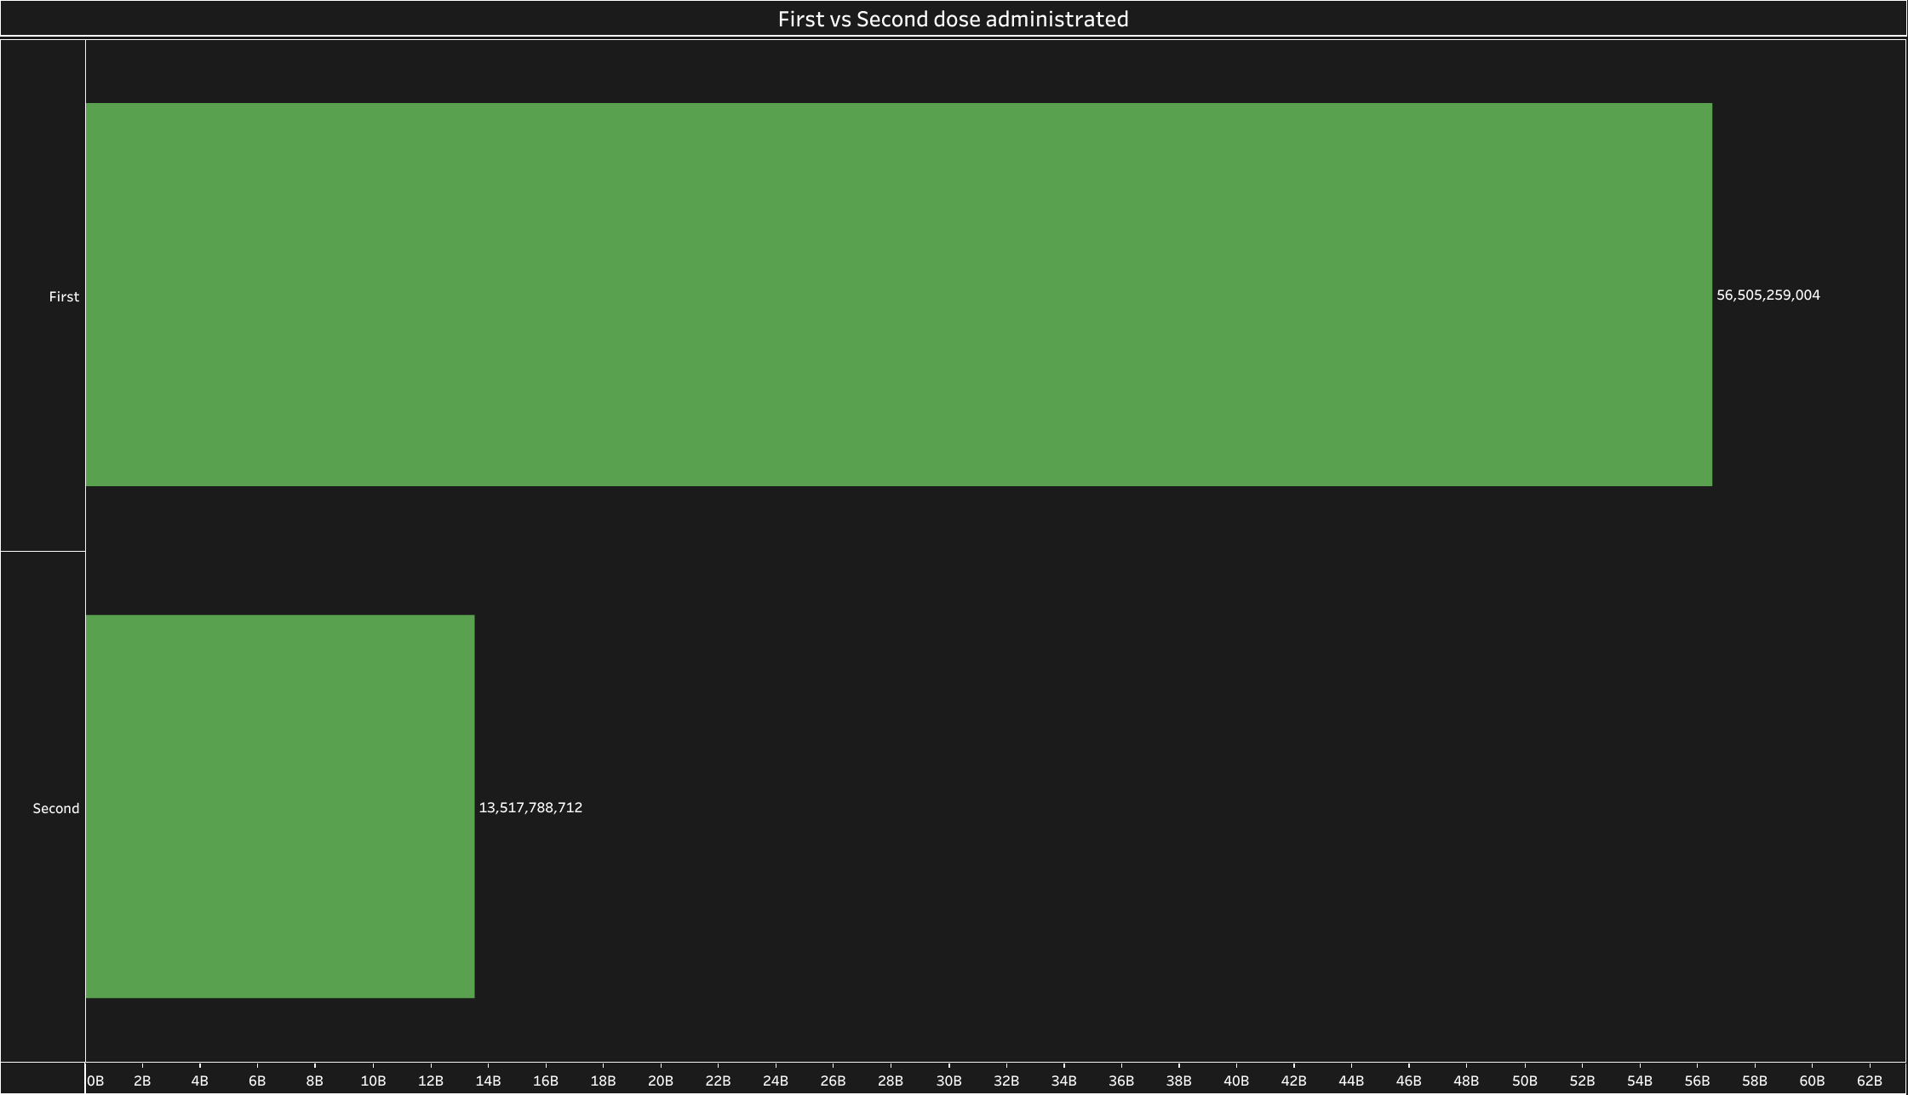

Slide 5
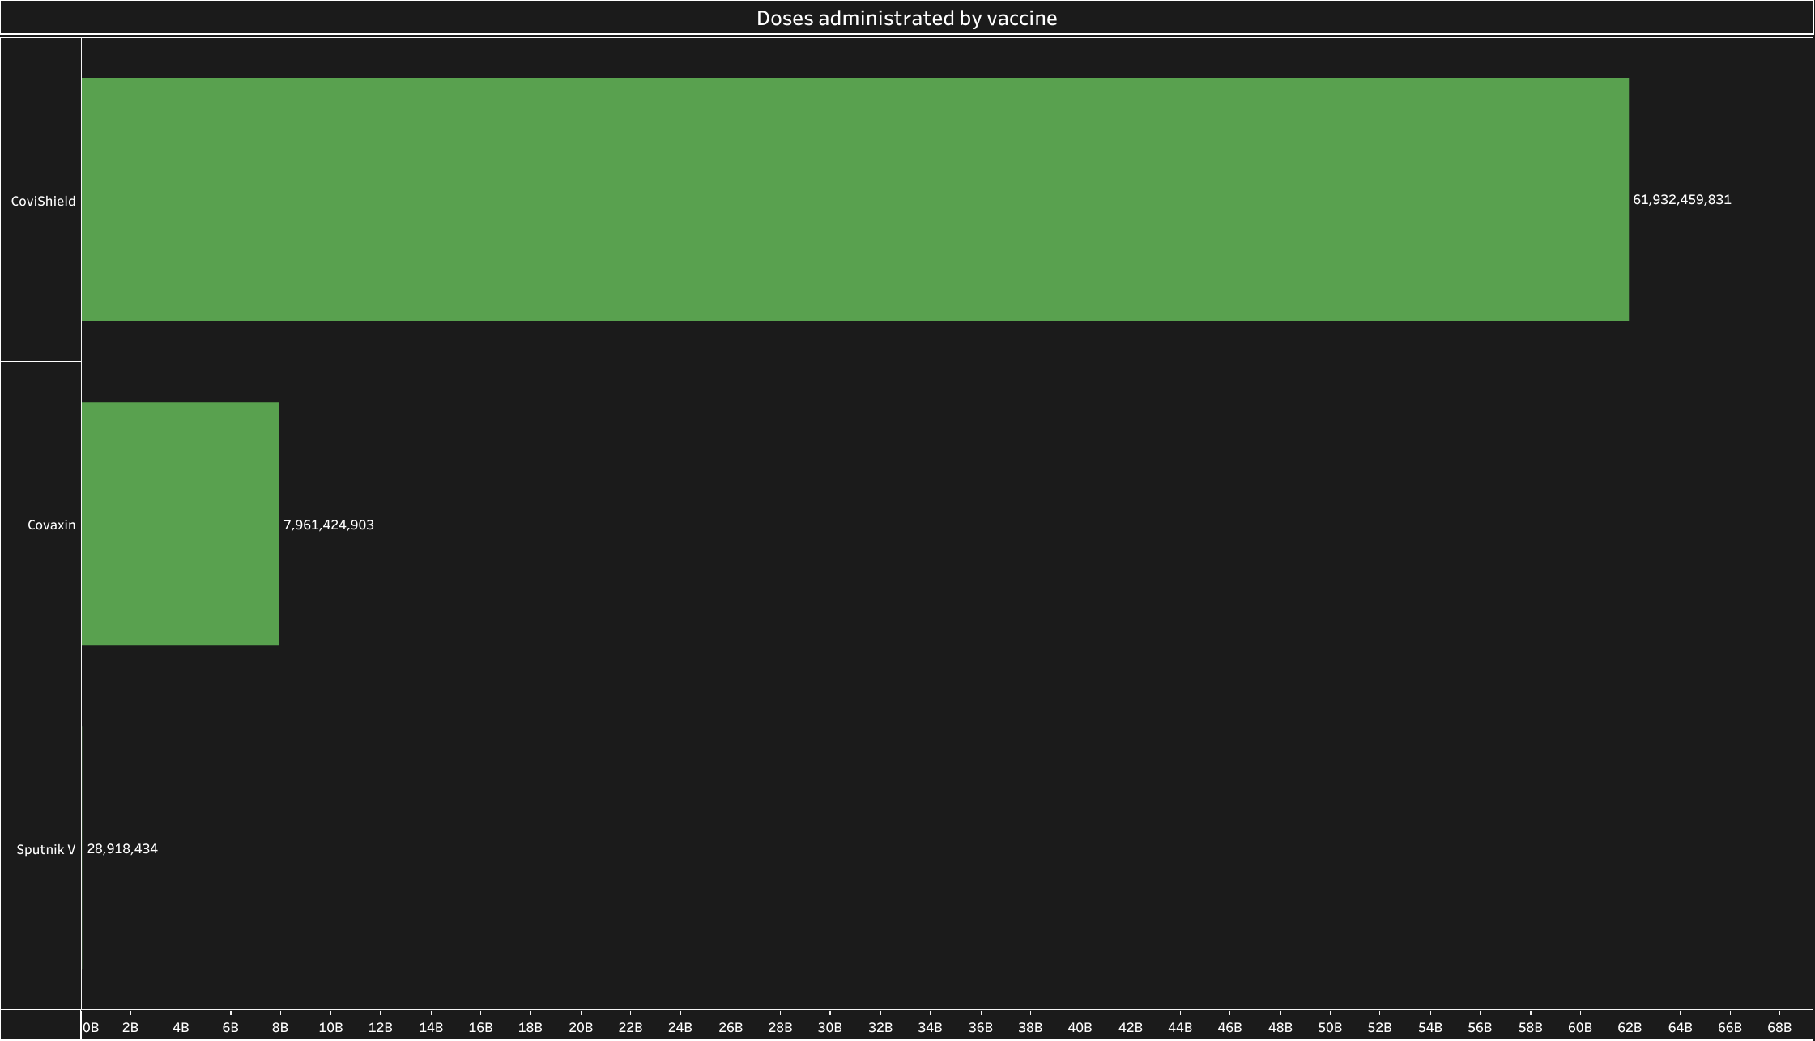

Slide 6
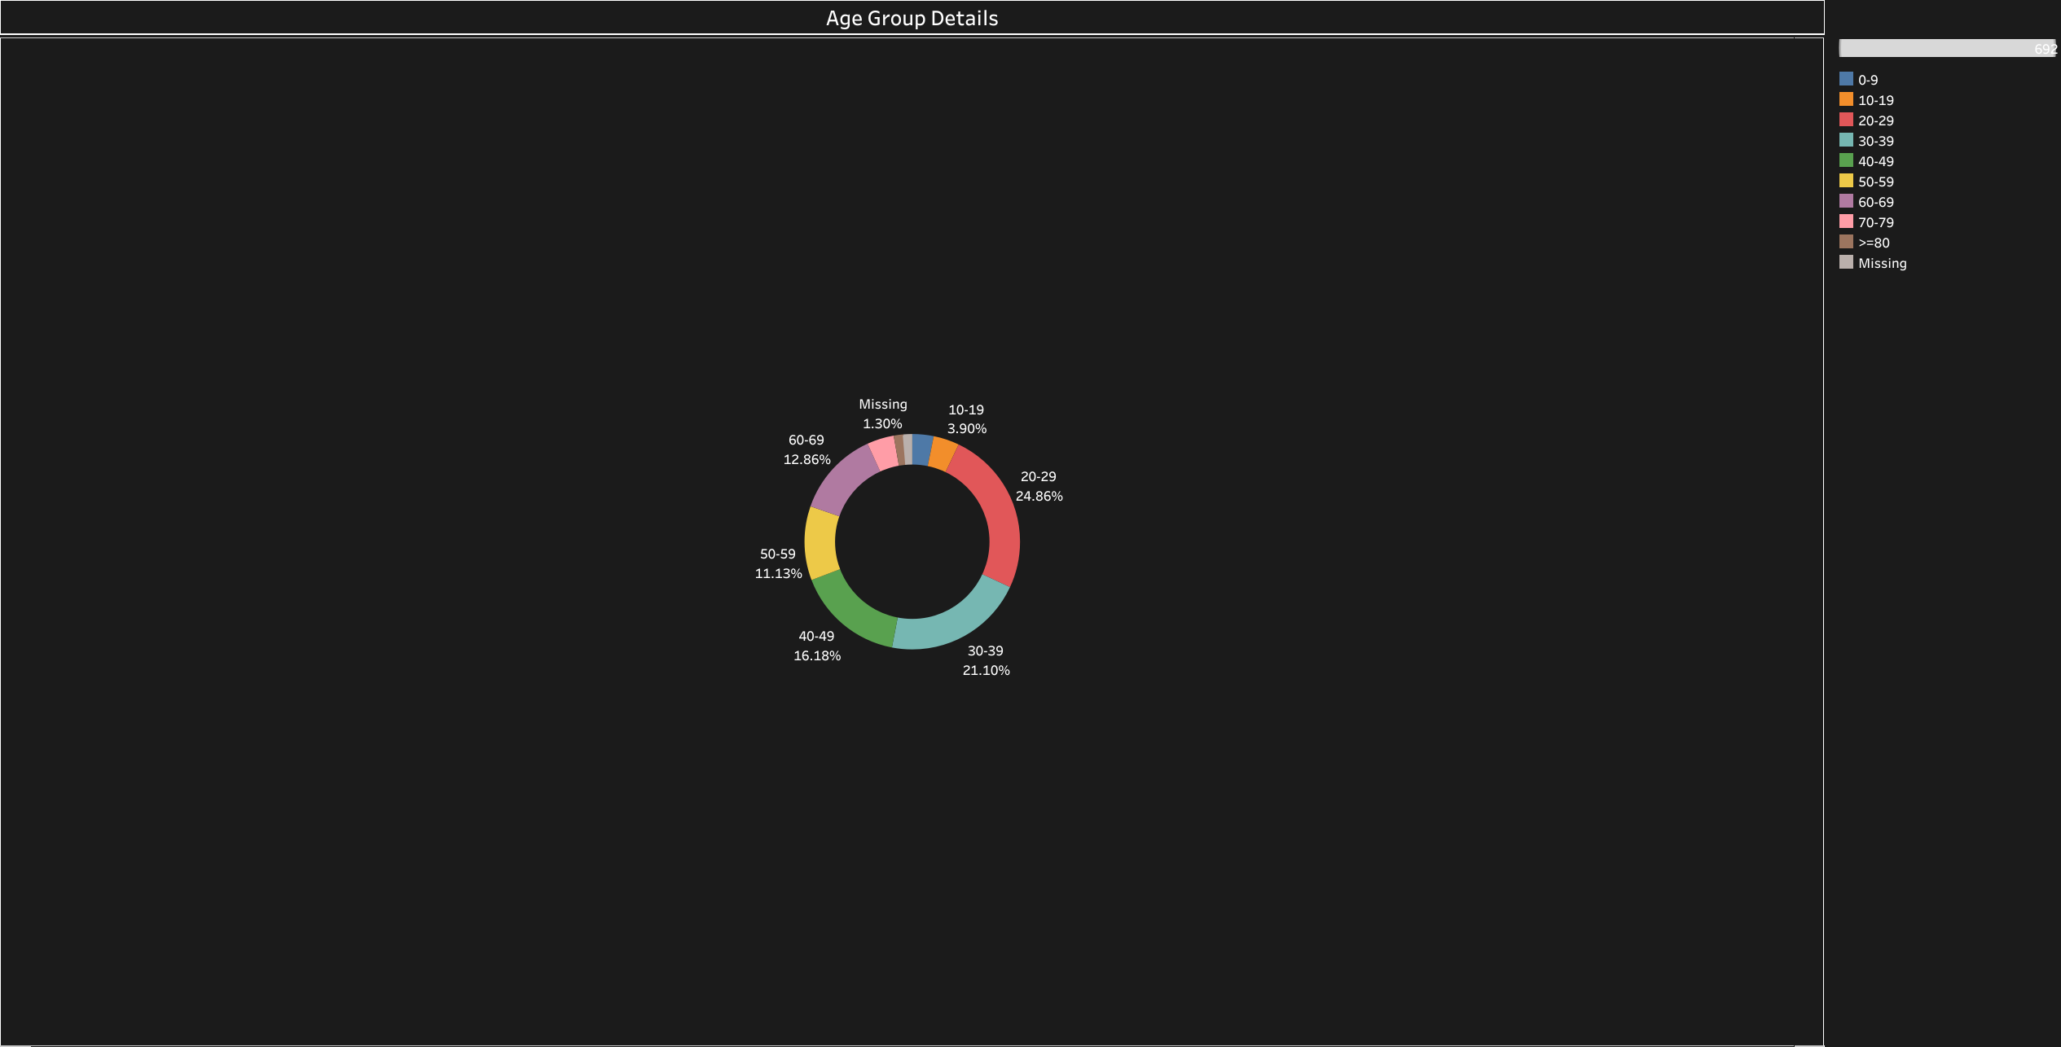

Slide 7
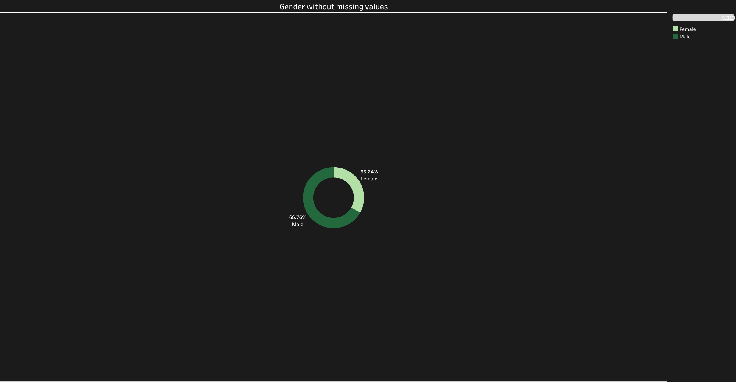

Slide 8
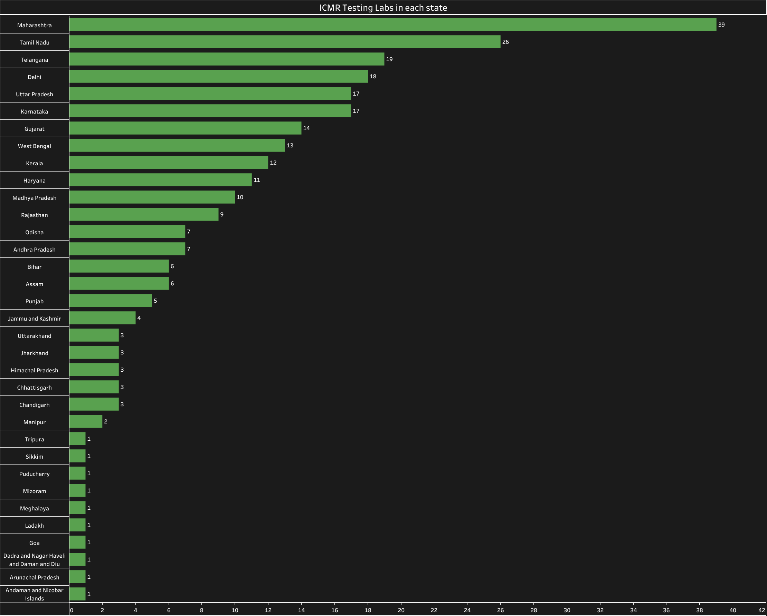

Slide 9
